Slide 1
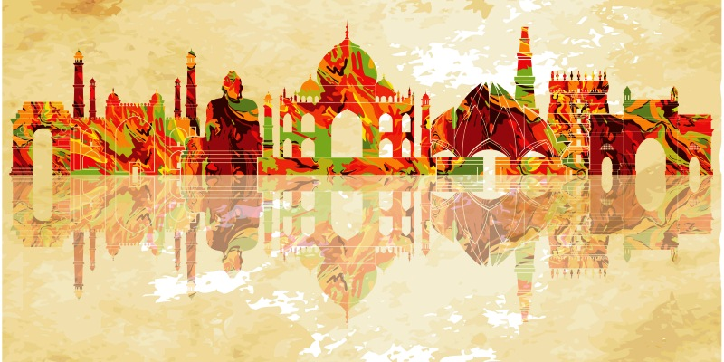
TOURISM IN INDIA (2016-2018)
SQL RESEARCH PROJECT
by- SHANTNU YADAV

Slide 2
CONTENTS
DATA ANALYSIS
OBJECTIVE
FACTORS
CIRCLE
MONUMENTS
CHANGE
%CHANGE
FINDINGS

Slide 3
TABLE ANALYSIS
THE DATA SET CONSIST OF INDIAN MONUMENTS ORGANISED BY ITS CIRCLE
IT ALSO CONSISTS OF NUMBER OF TOURIST(BOTH DOMESTIC AND FOREIGN) VISTED INDIAN MONUMENTS IN THE YEAR 2016-18

Slide 4
OBJECTIVES
Analyse the tourism in India for the given time period.
Publish the findings based on data analysis.

Slide 5
IMPORTANT FACTORS IN ANALYSIS
No. of foreign tourist by year.
No. of domestic tourist by year.
Total change in the number
% changes
Changes with respect to circles and monuments
Performance by circles and monuments

Slide 6
FACTORS RESPONSIBLE FOR DRASTIC VARIATION
Terrorism
Sudden rise in popularity
Election and other political scenarios.

Slide 7

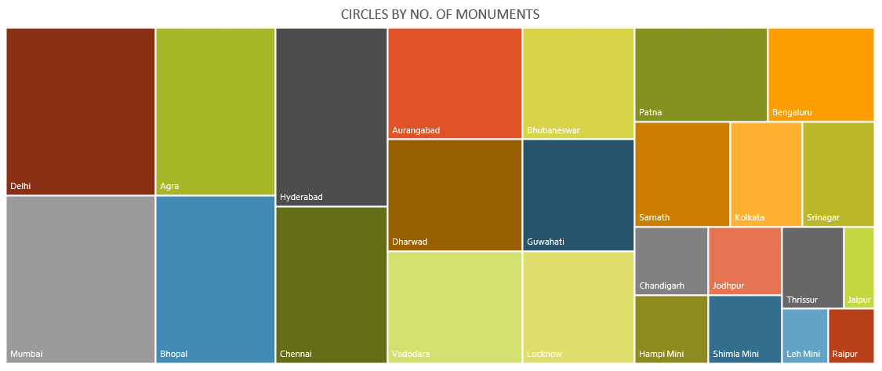
DATA ANALYSIS

Slide 8
DATA ANALYSIS
There are a total of 116 monuments located in 25 circles.
Delhi and Mumbai circles have max number of monuments in the ,which is 10.
Agra , Hyderabad and Bhopal follow the list with 8 monuments each.
Raipur, Jaipur and Leh mini has least with only 1 monument each.

Slide 9
CHANGE IN NUMBERS

Slide 10
CHANGE IN NUMBERS
The tourism industry has performed decent in these year with a 27.5% increase in total tourist.
Both foreign and domestic tourism has seen increase in the numbers, as foreign tourist increase by 24% and domestic tourist by 28%.
The number of domestic tourist remain ahead of foreign .

Slide 11
Tourism by circle
Agra received maximum number of tourist in these year .
1 out of every 5 tourist going t0 Agra Circle
Agra is closely followed by Delhi with 17% of total tourist.
Mumbai received only 7% of tourists even after having maximum number of monuments.

Slide 12
Tourism is Agra circle
Tourism in Agra is heavily dominated by Taj mahal and Agra fort.
They nearly accounts to 83% of foreign tourist and 75% of domestic tourist.
Fatehpur Sikri also receives decent percent of tourist.

Slide 13
Tourism by Circles
Sarnath circle showed best performance mainly due to foreign tourist.
Three circles (Lucknow, Delhi and Vadodara) experienced decrement in tourist arrival.
Lucknow circle had the most % decline as it looses 1/4th of its tourist compared to last year.
It can be due to 2017 Vidhan sabha election in the state.

Slide 14
Tourism by monuments
Taj mahal comes out as most popular monuments among both domestic and foreign tourist
It received approx. 7.8 million tourist in period.
Agra fort and Qutab Minar is also highly popular among tourists.

Slide 15
% Change in tourism by Monuments
Excavated remains at Sarnath shows a peak increment as it opens for Foreigner .
Avantiswamin Temple Avantipur Distt. Pulwama also as huge increment as last year it was mostly closed due to disturbed peace.
Few monuments also showed decrement in tourist visit.

Slide 16
FINDINGS
Taj Mahal is the most visited Indian monument.
Agra circles receives most no. of domestic and foreign tourist every year.
Even after having most no. of monuments, Mumbai circle receives only 7% of total tourist.
Somnath circle has received massive increment in foreign tourist after it opened it opened Excavated remains at Sarnath for tourists.
Tourism can be affected by terrorism, election, riots and other political and social scenarios.

Slide 17
Thank you

